Slide 1
The History of the GPU
by Nick Driscoll

Slide 2
Introduction
My name is Nick Driscoll
Employed by LunarG working on one of the Vulkan SDK tools
Six years experience with GPU and 3D graphics programming
Developing a game with a custom engine including graphics tech
Excited to show the evolution of GPUs

Slide 3
Agenda
Discuss 3D rendering before the advent of the graphics cards
Quick explanation of the 3D drawing algorithm GPUs use
Discussion of how each era of GPU shaped the graphics of that generation
Triangle rasterizers (1995-1999)
Hardware transform & lighting (1999-2002)
Programmable vertex and pixel shaders (2002-2009)
Compute shaders (and others) (2009-2018)
Modernity (RT, DLSS, frame generation) (2018-present)

Slide 4
Disclaimers
We will be focused on PC, with some references to contemporary consoles
We won’t be covering the development of mobile graphics chips as found in smartphones, tablets, Nintendo Switch, etc.
Details have been simplified to protect the innocent

Slide 5
Pre-hardware acceleration (pre-1995)
The earliest 3D games on PC had to make do with CPU-drawn graphics
CPU’s are poorly designed for the task of graphics rendering
Elements (vertices, polygons, pixels) must be processed serially
The sheer number of pixels demands a lot from the memory controller (320x200 resolution means 64,000 pixels need processed)
The CPU still has to run the rest of the game!!!

Slide 6
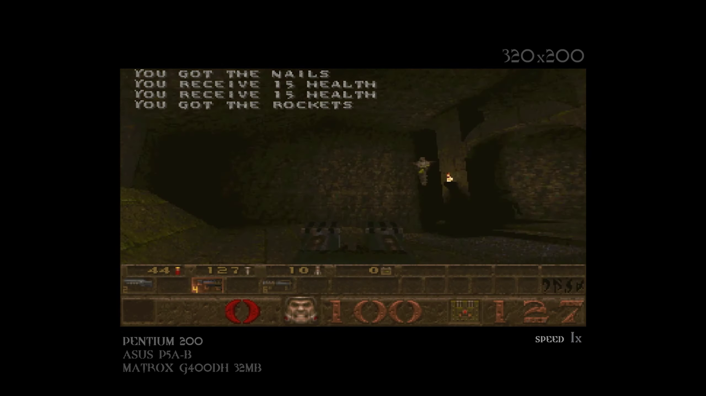
Pre-hardware acceleration ( Quake 1996 example)
Benchmarking with Pentium 200
Released 12 days before Quake, allegedly very expensive/rare
320x200 → 46.5 FPS
640x480 → 17 FPS
This is with Quake using every trick in the book!
It quickly became obvious that hardware acceleration would be required...

Slide 7
Brief 3D primer: what exactly are we hardware accelerating?
CPU graphics: the programmer chooses scene representation/drawing algorithms as they see fit
In order to design specialized graphics coprocessors, we need a standard drawing algorithm that can be implemented in hardware
Scene representation
Objects are represented by a list of triangles in 3D space
Triangle surfaces are detailed using 2D images called textures
Lights are represented as either points in the scene or fixed direction vectors (sunlight)
3D pipeline
Triangles specified in a coordinate system local to the 3D model called “model-space” are transformed to “screen-space”, the screen’s local coordinate system
These screen-space triangles are tested against each screen pixel to determine coverage
Texture/lighting data are combined to form each pixel’s color

Slide 8

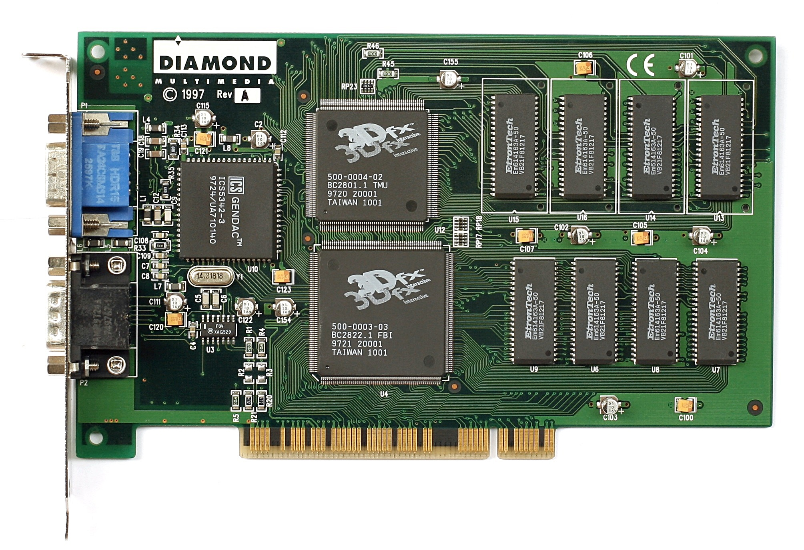
Triangle rasterizers (1995-1999)
Of the steps in the pipeline, pixel processing is most expensive
Large number of screen pixels (many more than vertices)
Texturing (perspective-correction, filtering, lighting)
One pixel’s processing is independent of all the others
Enter 3dfx
Manufacturers of the Voodoo 3D accelerator chipset
Hardware OEMs buy the chipset to make graphics cards (like today)
Pictured is the Diamond Monster 3D, the most popular Voodoo graphics card
PS1’s graphics chip is comparable*
Notes:
The pictured graphics card is a Diamond Monster 3D, the most popular card using the Voodoo 1 chipset

Slide 9
Triangle rasterizers (cont.)
CPU responsibilities
Send transformed and lit triangle data to accelerator each frame
Set up accelerator state, including which texture(s) to sample from during pixel processing, camera position and properties, etc.
3D accelerator responsibilities
Rasterize triangles
Apply textures to pixels while taking lighting into account
Notes:
The pictured graphics card is a Diamond Monster 3D, the most popular card using the Voodoo 1 chipset

Slide 10
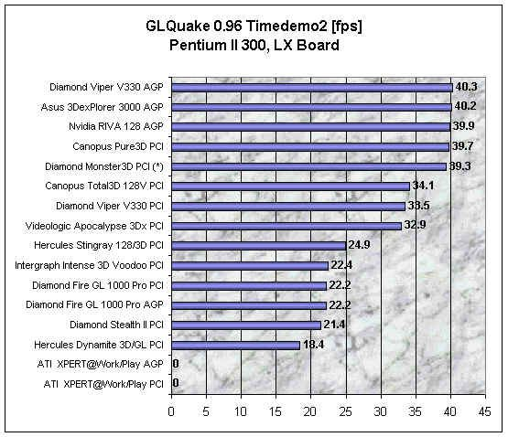
Triangle rasterizers (Quake example)
Benchmarking in 640x480
CPU alone: 17 FPS (58.8 ms)
DM3D: 39.3 FPS (25.4 ms)
56.8% improvement!
The CPU is still doing half the graphics work!
Aside: contemporary Quake gamers considered 12-15 FPS acceptable in SP
Notes:
The pictured graphics card is a Diamond Monster 3D, the most popular card using the Voodoo 1 chipset

Slide 11
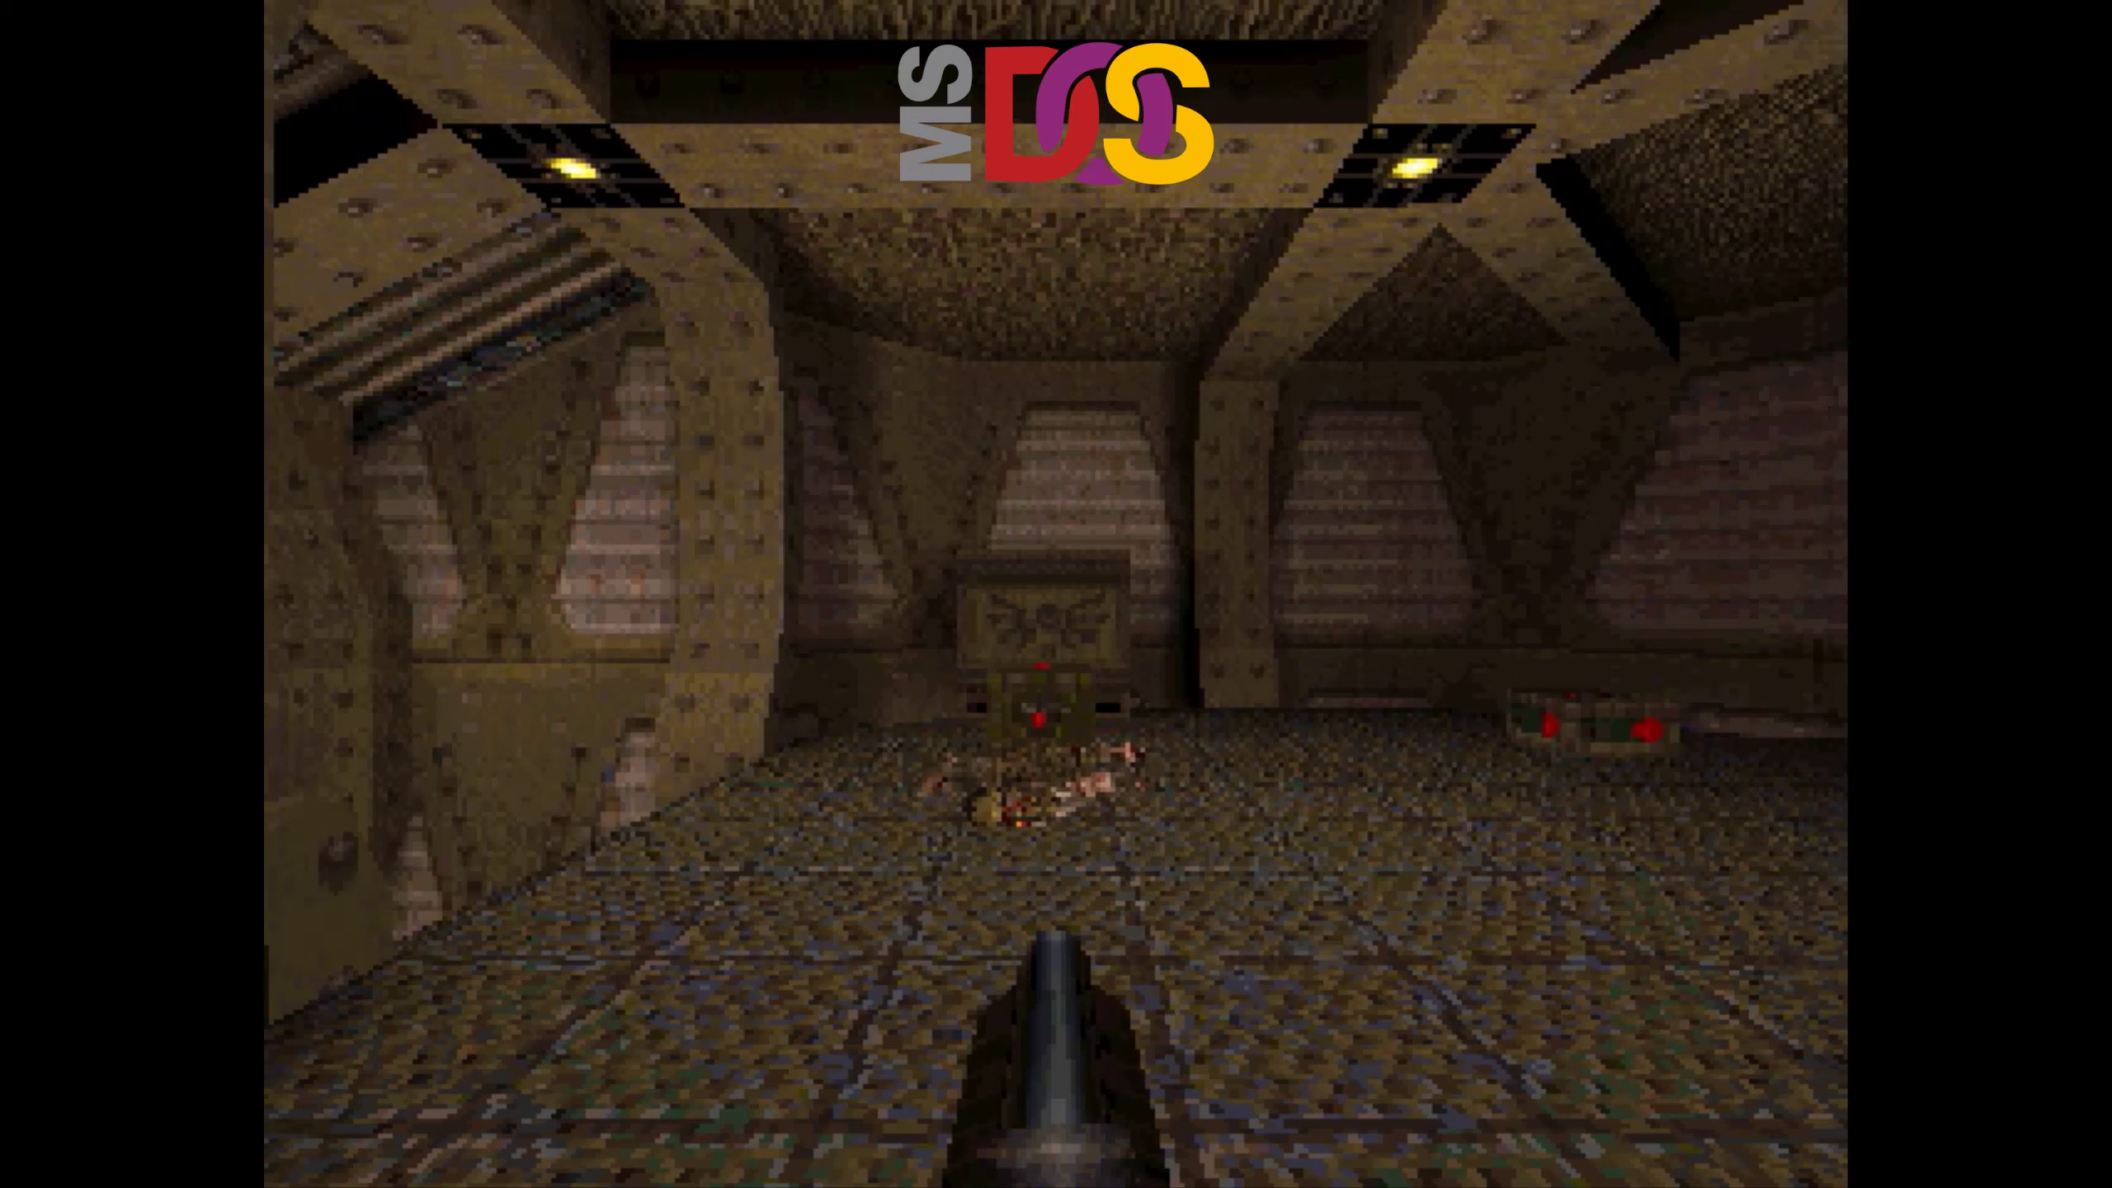
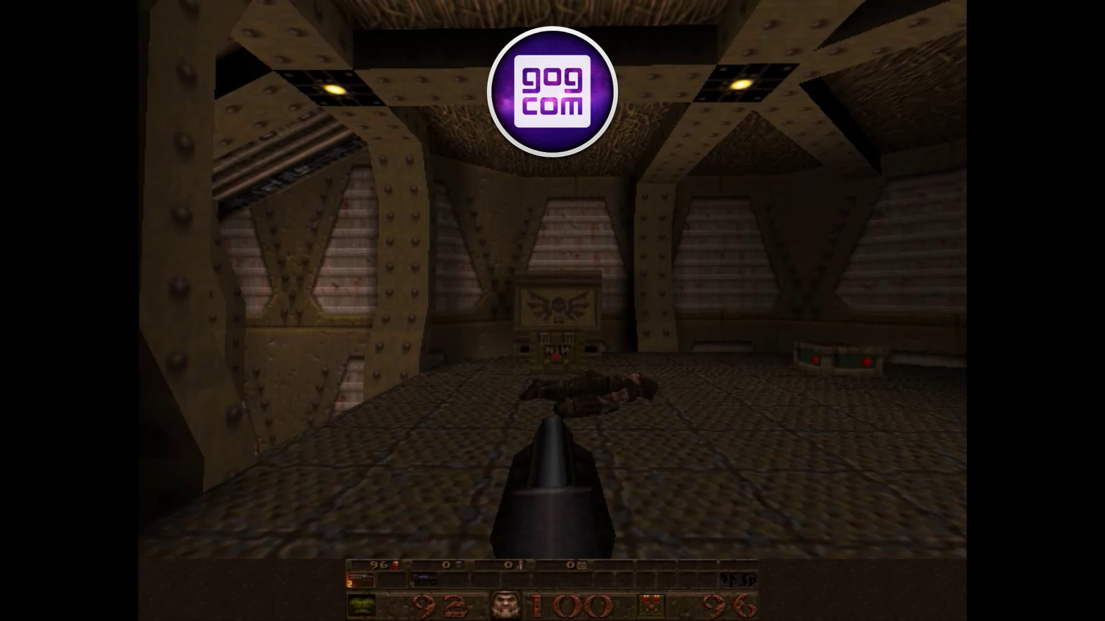
Triangle rasterizers (Quake comparison)
Higher resolution textures, texture filtering, higher color depth, etc.
Notes:
The pictured graphics card is a Diamond Monster 3D, the most popular card using the Voodoo 1 chipset

Slide 12
Hardware Transform & Lighting (1999-2002)
Rasterizing triangles and shading pixels is only half the battle
Transforming triangles into screen-space: multiply a matrix by each vertex position
Lighting triangle: Dot vertex normal with light direction
These calculations are independent per-vertex
This makes vertex processing the next clear bottleneck to accelerate with hardware

Slide 13
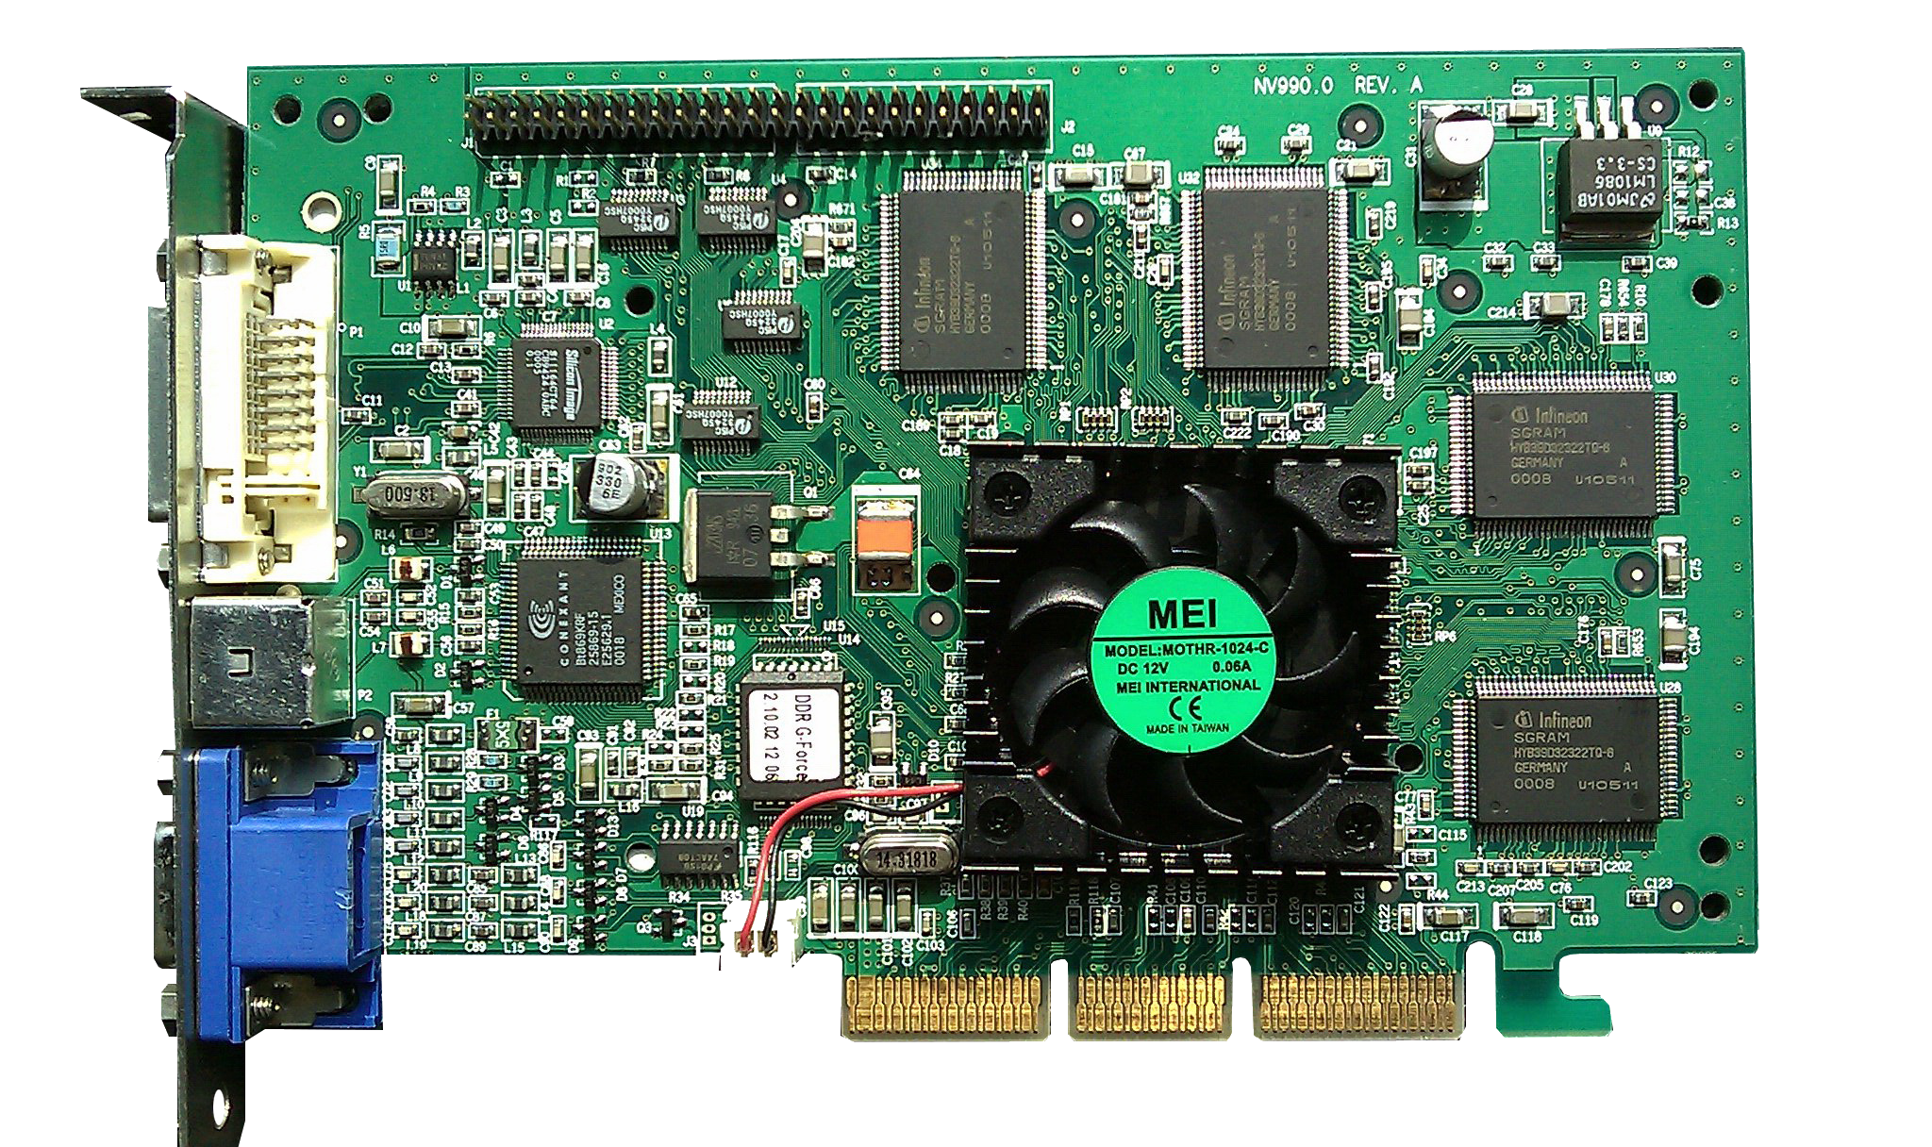
Hardware Transform & Lighting
Geforce 256 (Oct 11. 1999)
First consumer graphics chip to support hardware T&L
NVIDIA marketing coins the term GPU for cards with hardware T&L
Additional texture types (cubemaps)
N64 had a comparable GPU

Slide 14
Hardware Transform & Lighting (cont.)
CPU responsibilities
Provide model-space geometry ahead of rendering (on level load)
Send a transform matrix (64 bytes) for each object each frame
GPU responsibilities
Multiply each object’s matrix by the model-space position of each vertex in order to obtain its screen-space position
Compute lighting per-vertex
Rasterize and texture the triangle’s pixels while accounting for vertex lighting

Slide 15
Hardware Transform & Lighting (Half-Life example)
Half-Life’s (Nov 19. 1998) game engine (goldsrc) is a fork of the Quake engine (idtech3) specifically the GLQuake version
Blue Shift (Jun 12. 2001), required hardware T&L support in order to facilitate massively increasing the triangle counts of objects

Slide 16
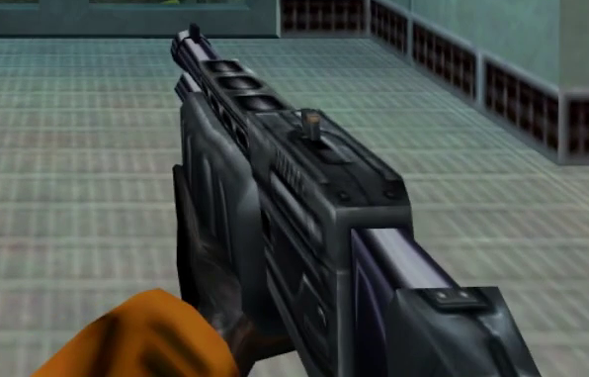
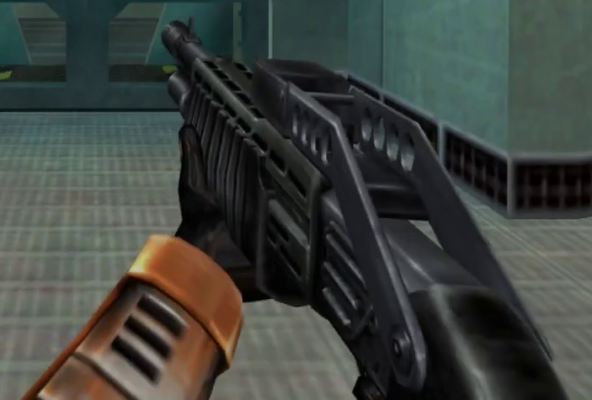
Hardware Transform & Lighting (Half-Life example)

Slide 17
Programmable vertex and pixel shaders (2002-2009)
At this point, GPU’s have tackled the two largest bottlenecks in 3D graphics rendering
Problem: Operations performed on vertices and pixels by GPUs are defined by configurable, fixed-function operations
This leads to games looking samey as all games that render with hardware have the same set of graphics algorithms available to them
A way to specify the behavior of the vertex and pixel processing stages with code was highly desired at the time

Slide 18
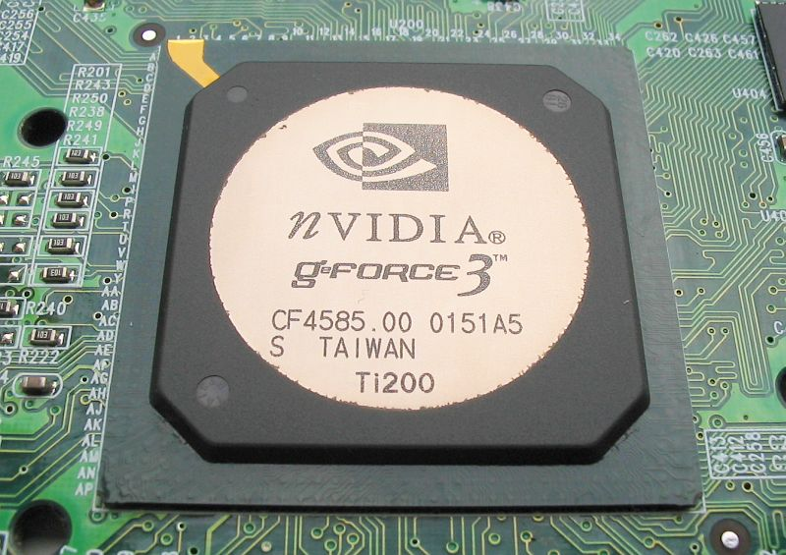
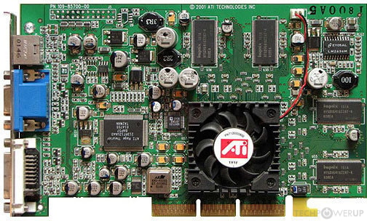
Programmable vertex and pixel shaders (prelude)
Unfortunately programmers would have to suffer a little before relief would come
NVIDIA’s GeForce 3 is the first GPU to introduce programmability, yay!!!
Except only for vertex processing…
But wait! ATI comes to the rescue with the Radeon 8500!!!
Just kidding, it only supports pixel processing…
So I won’t be considering GPUs like these to be of their own era

Slide 19
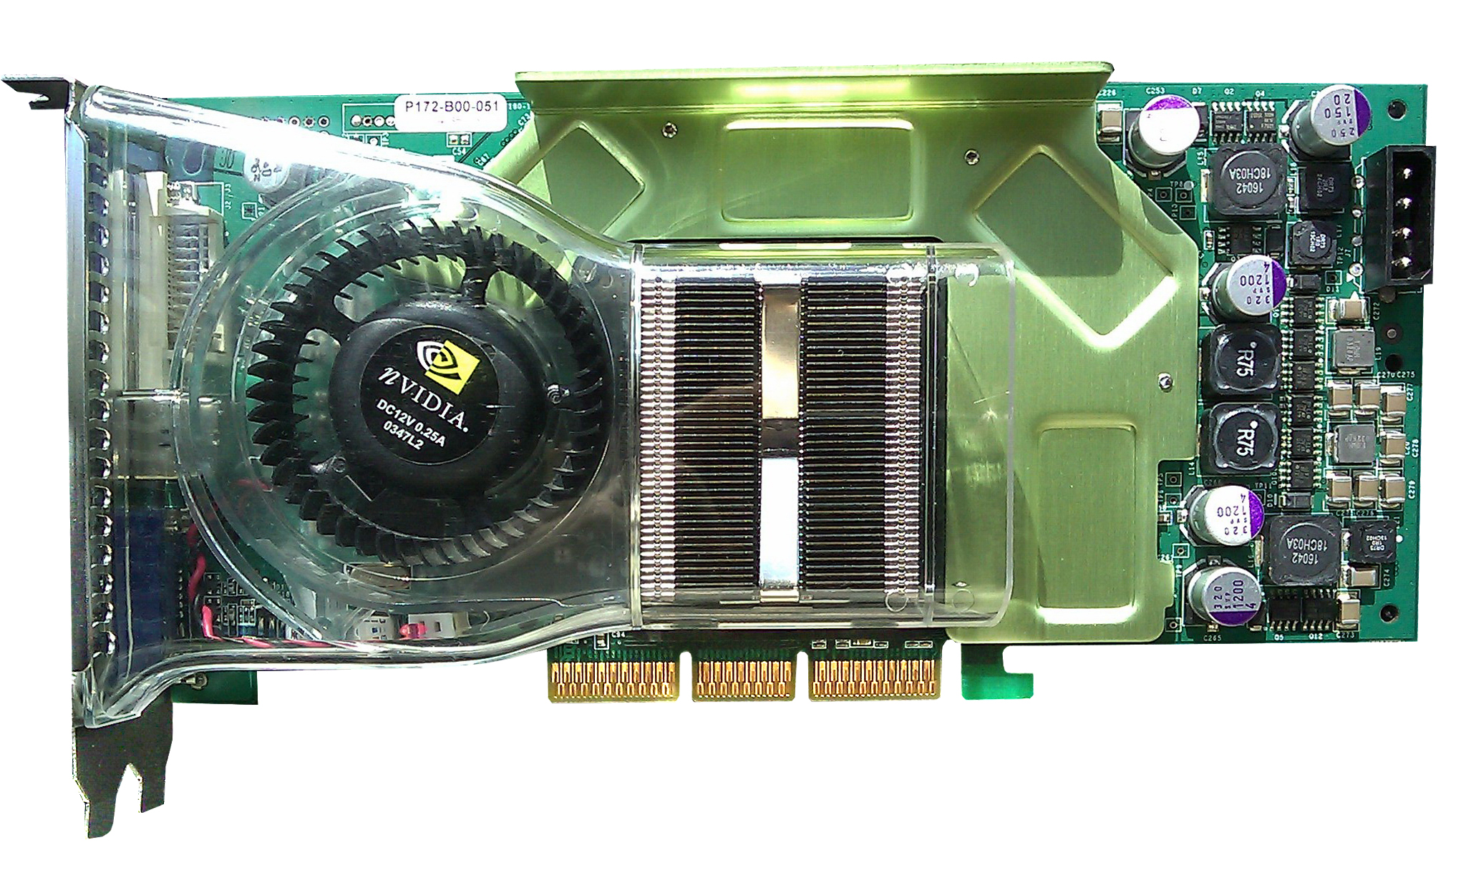
Programmable vertex and pixel shaders
GeForce FX series (Jan 27. 2003) of cards finally introduces true vertex and pixel shaders
This offers performance benefits, but it also enabled some effects that would have been impossible before
Per-pixel lighting
Bump mapping
Vertex animation
Xbox 360 is comparable

Slide 20
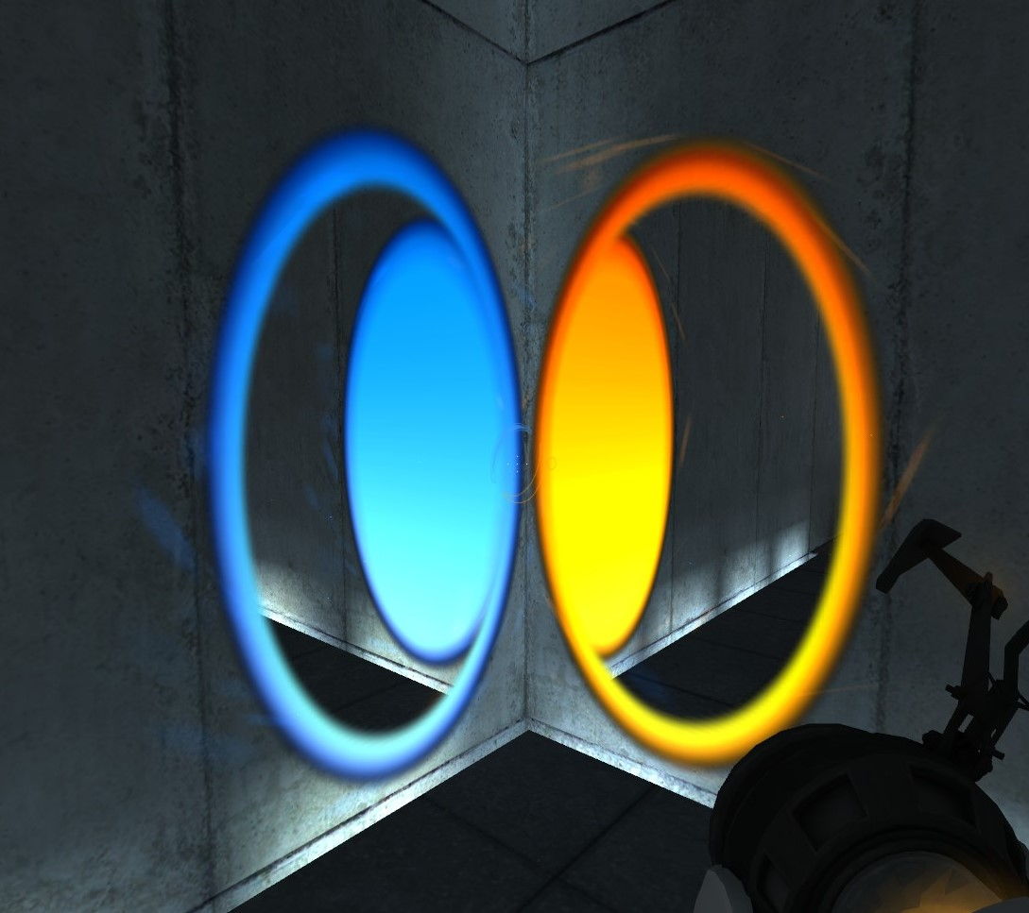
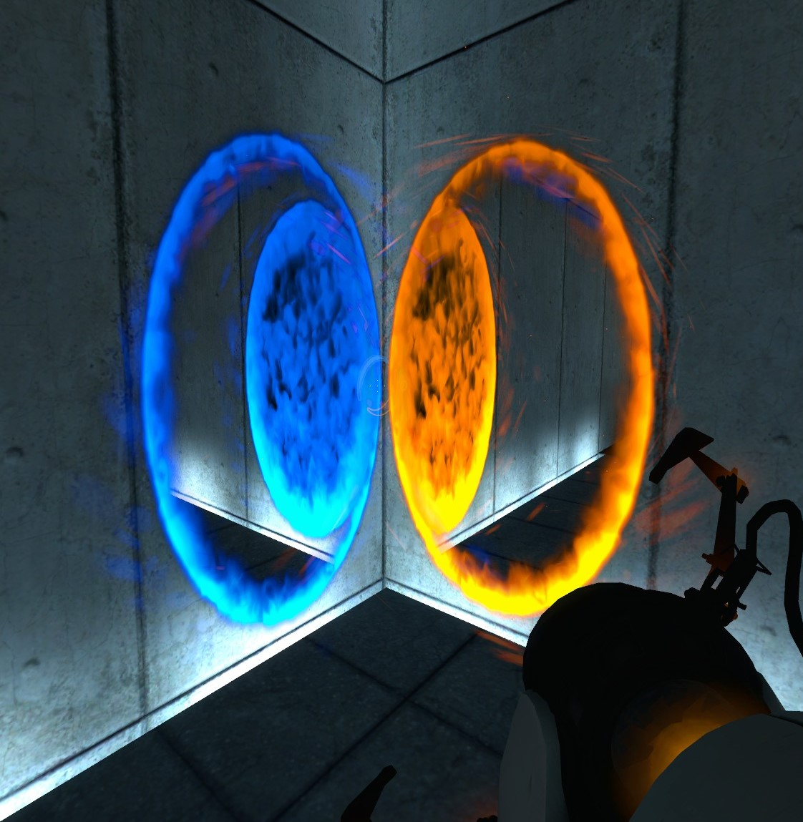
Programmable vertex and pixel shaders (Portal example)

Slide 21
The extra shaders that sucked
After vertex and pixel shaders, there were a few missteps on the way to the next era in GPUs
Geometry shaders
These shaders allow you to “amplify” geometry, running once per “primitive” (point, line, triangle) generating extra primitives
Problematic for performance reasons
Tessellation (hull/domain) shaders
Another geo amplification system, this time with two extra shader types and a fixed-function block in-between

Slide 22
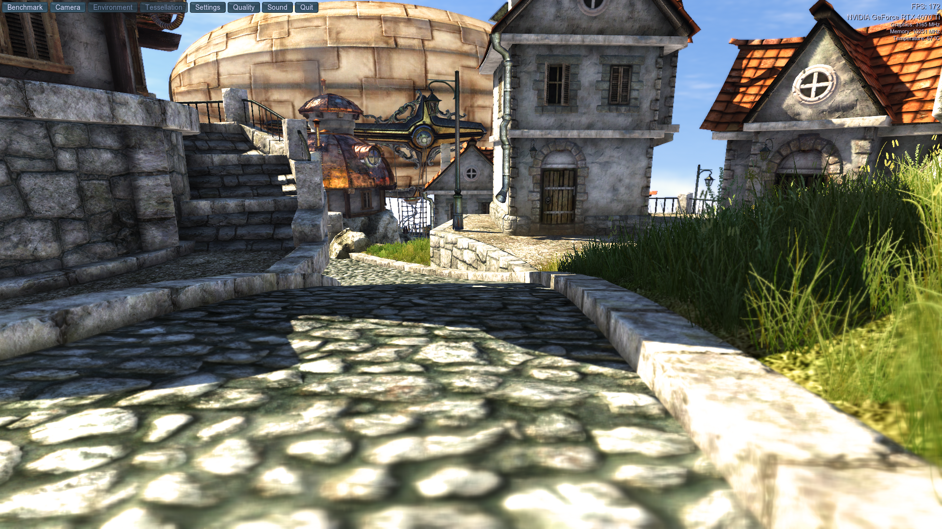
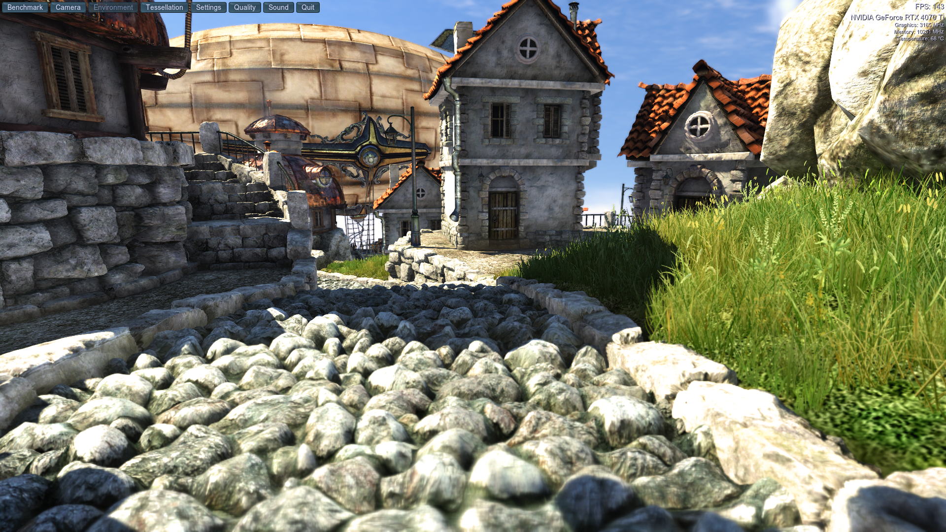
Tessellation shaders example

Slide 23
Compute shaders (2009-2018)
Developers knew that further programmability was the future
GPUs were already using a unified shader architecture
All shader types run on same hardware cores for load balancing
Using GPUs for general-purpose computing had been around for a few years via NVIDIA’s CUDA API (Feb 16. 2007)
Vertex/pixel shaders are dispatched based on number of vertices or number of pixels so...
What if programmers could manually specify how a shader is dispatched?

Slide 24
Compute shaders (cont.)
DirectX 11 (Oct 27. 2009)
Introduces the compute shader, allowing programmers to specify arbitrary work for the GPU to execute
Any (parallel) workload is fair game!
Using GPUs for general-purpose computing had been around for a few years with NVIDIA’s CUDA (Feb 16. 2007)
As such there isn’t a good GPU to represent the introduction of the functionality. API support was the blocker!
PS4/XbOne GPUs are of this era

Slide 25
Compute shaders (cont.)
Crucially, compute shaders can do the jobs of both the Geometry and Tessellation shaders, and so much more
Frustum culling on GPU
Tile-based light binning
GPU-driven physics
GPU-driven skinned animation (I’ve implemented this!)
GPU-driven anything

Slide 26
Modernity (RT, DLSS, frame generation) (2018-present)
At this point things are looking great for GPUs
Vertex and pixel shaders can be as long and complicated as developers need them to be
Compute shaders have arrived to facilitate moving arbitrary work to the GPU
Graphics programmers have become so skilled at cheating with textures and simple lights that games begin to approach photorealism

Slide 27
Modernity (RT, DLSS, frame generation)
What is raytracing (RT), why is it important?
In rasterization, we transform triangles to screen space and computing the pixel coverage directly. This is fast
In raytracing, each pixel is assigned one or more rays that shoot from the camera into the scene, bounce around, and eventually converge to the final color of said pixel. This is very slow
Historically, raytracing was invented before rasterization, but due to performance reasons, raytracing has always been completely infeasible for realtime graphics

Slide 28
Modernity (RT, DLSS, frame generation)
The photorealistic graphics I alluded to are only possible by using techniques that simulate raytracing
Dynamic cubemaps: Used for RT-less dynamic reflections
Shadow maps: Used for RT-less shadows
Lightmap/probe baking: Used for RT-less global illumination
This last one is the big one as waiting on light baking kills artist iteration time/sanity
Raytracing solves (or at least could solve) all of these problems

Slide 29
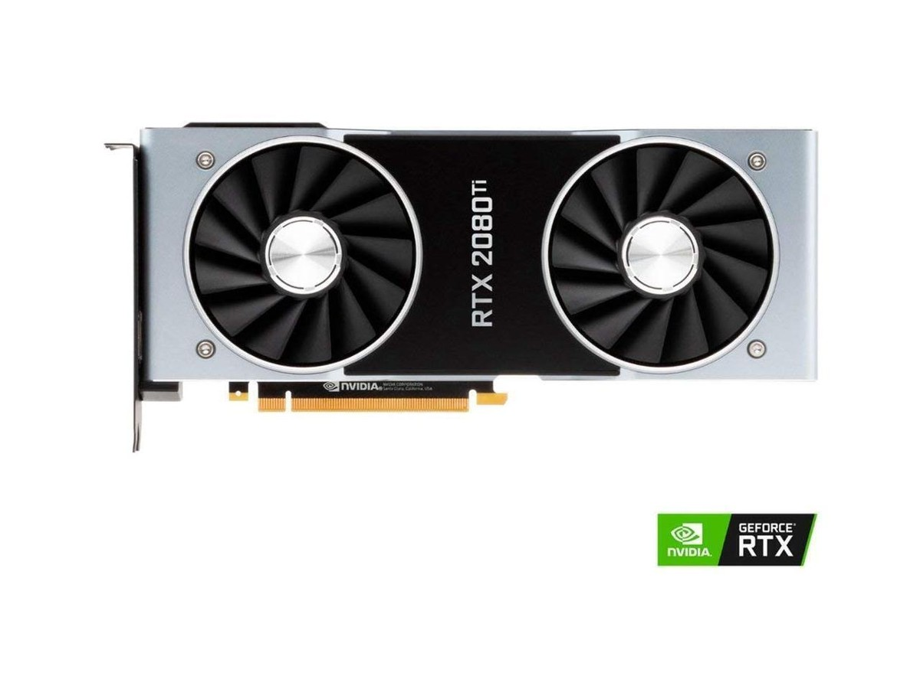
Modernity (RT, DLSS, frame generation)
Enter the RTX 2000 series GPUs
Adds RT cores for hardware accelerated raytracing
Introduces entire separate rendering algorithm for RT
Modern console GPUs are… comparable, yeah, lets go with that
However, even the most expensive, modern RTX card can’t hit 60FPS in a modern RT game…

Slide 30
Modernity (RT, DLSS, frame generation)
Enter DLSS (Deep-Learning Super Sampling)
Just as the RTX cards added RT cores, they also added “tensor” cores for accelerating neural network evaluation
Can’t run the game with RT at 1440p? Just render in 720p and use DLSS to magically upscale!
As of RTX 4000 series cards, DLSS can also generate every other frame for you and help your app choose better rays for RT

Slide 31
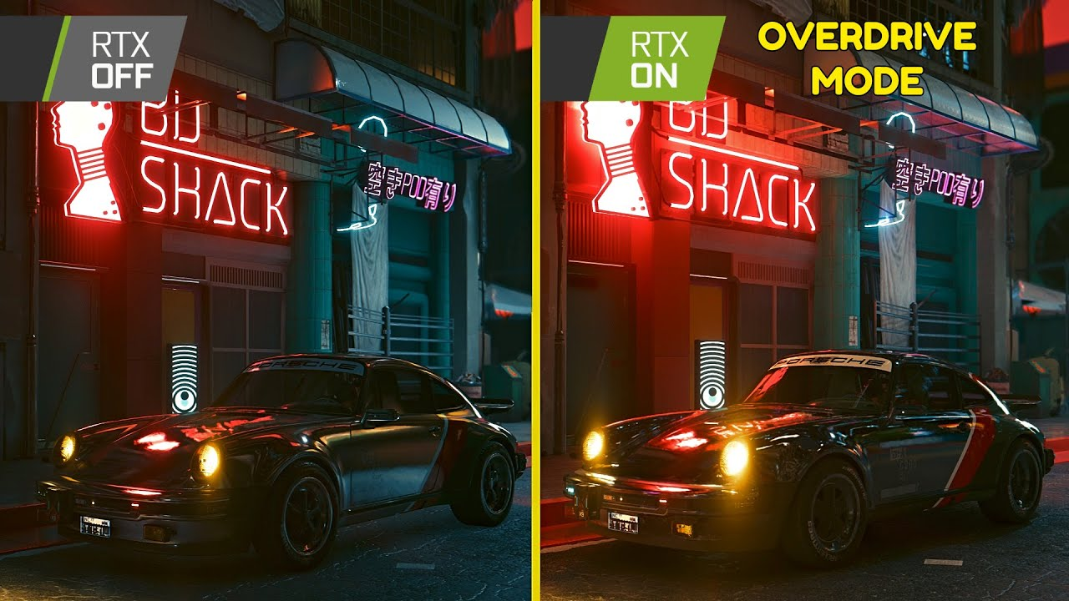
Modernity (RT, DLSS, frame generation) example

Slide 32
Modernity (RT, DLSS, frame generation)
The elephant(s) in the room
GPUs have become super luxury items
Cryptocurrency
LLM worship
Financial speculation/scalping
The returns, at present, are questionable
Noisy/blurry image quality
More compromises in non-PT apps
Stagnation due to lack of adoption

Slide 33
References
https://www.dosdays.co.uk/topics/1996.php
Graphics Programming Black Book by Michael Abrash
https://www.youtube.com/watch?v=5r53B32YOdQ
https://www.youtube.com/watch?v=gP_hsq5vIvc
https://www.gamestar.de/artikel/das-voodoo-zeitalter-wie-3dfx-die-welt-der-pc-grafik-veraenderte,1951475.html
https://www.tomshardware.com/reviews/real-thing,45.html
https://developer.download.nvidia.com/assets/gamedev/docs/Microsoft_DirectX_7.PDF
https://www.pcgamingwiki.com
https://www.khronos.org/opengl/wiki/History_of_Programmability
https://www.pny.com/file%20library/company/support/product%20brochures/geforce%20graphics/user%20guides%20and%20tutorials/microsoftdirectx_v1.pdf

Slide 34






Q&A
Question time!
Blog: https://nickdriscoll.github.io/
@nickdrisc0ll.bsky.social
youtube.com/Nickmav1337

